Slide 1


Miguel Baidal Marco
07/11/2022

Slide 2

Outline
Executive Summary
Introduction
Methodology
Results
Conclusion
Appendix

Slide 3
Executive Summary
To analyze data were used these methodologies:
Web scraping and the SpaceX API
Exploratory Data Analysis (EDA)
Machine Learning
As results:
EDA identifies which the best features to predict the level of success in launchings
Machine Learning got the best model to predict which characteristics were the most important using the available data

Slide 4
Introduction
The objective is to know if the new company Space Y could compete against Space X answering:
Estimating the total cost of launches by predicting the number of successful landings of the first stage of rockets
Where is the best place in a map to make launches

Slide 5

Section 1

Slide 6
Methodology
Executive Summary
Data collection methodology:
Data from Space X was gotten from 2 sources:
Space X API
WebScraping
Perform data wrangling
The collected data was enriched by creating a landing label based on available data after summarizing and analyzing features
Perform exploratory data analysis (EDA) using visualization and SQL
Perform interactive visual analytics using Folium and Plotly Dash
Perform predictive analysis using classification models
Data collected until this step was normalized and also divided in training and test sets, and after that, evaluated with four different classification models

Slide 7
Data Collection
Data sets were collected from Space X API and from Wikipedia using web scraping technics.

Slide 8
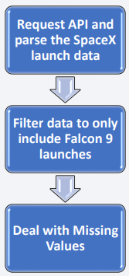
Data Collection – SpaceX API
SpaceX offers a public API from where data can be obtained
Source code:
https://github.com/Wasousky/IBM_Curso/blob/main/Data%20Collection.ipynb

Slide 9
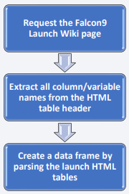
Data Collection - Scraping
Data from Space X can be obtained from Wikipedia by Webscraping too.
https://github.com/Wasousky/IBM_Curso/blob/main/Data%20Collection%20Web%20Scraping.ipynb

Slide 10
Data Wrangling
An Exploratory Data Analysis (EDA) is performed on the dataset.
Then the summaries launches per site, occurrences of each orbit and occurrences of mission outcome per orbit type were calculated.
Finally, the landing outcome label was created.
https://github.com/Wasousky/IBM_Curso/blob/main/Data%20Wrangling.ipynb

Slide 11
EDA with Data Visualization
To explore data, scatterplots and barplots were used to visualize the relationship between pair of features:
Payload Mass X Flight Number
Launch Site X Flight Number
Launch Site X Payload Mass
Orbit and Flight Number
Payload and Orbit
https://github.com/Wasousky/IBM_Curso/blob/main/EDA%20Data%20Visualization.ipynb

Slide 12
EDA with SQL
The following SQL queries were performed:
• Names of the unique launch sites in the space mission;
• Top 5 launch sites whose name begin with the string 'CCA’;
• Total payload mass carried by boosters launched by NASA (CRS);
• Average payload mass carried by booster version F9 v1.1;
• Date when the first successful landing outcome in ground pad was achieved;
• Names of the boosters which have success in drone ship and have payload mass between 4000 and 6000 kg;
• Total number of successful and failure mission outcomes;
• Names of the booster versions which have carried the maximum payload mass;
• Failed landing outcomes in drone ship, their booster versions, and launch site names for in year 2015;
https://github.com/Wasousky/IBM_Curso/blob/main/EDA.ipynb

Slide 13
Build an Interactive Map with Folium
Markers, circles, lines and marker clusters were used with Folium Maps
• Markers indicate points like launch sites;
• Circles indicate highlighted areas around specific coordinates, like NASA Johnson Space Center;
• Marker clusters indicates groups of events in each coordinate, like launches in a launch site;
• Lines are used to indicate distances between two coordinates.
https://github.com/Wasousky/IBM_Curso/blob/main/Interactive%20Visual%20Analytics%20with%20Folium%20lab.ipynb

Slide 14
Build a Dashboard with Plotly Dash
The following graphs and plots were used to visualize data:
• Percentage of launches by site
• Payload range
This combination allowed to quickly analyze the relation between payloads and launch sites, helping to identify where is best place to launch according to payloads.

Slide 15
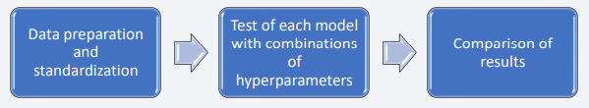
Predictive Analysis (Classification)
Four classification models were compared:
logistic regression
support vector machine
decision tree
k nearest neighbors
https://github.com/Wasousky/IBM_Curso/blob/main/Machine%20Learning%20Prediction.ipynb

Slide 16
Results
Exploratory data analysis results:
• Space X uses 4 different launch sites
• The first launches were done to Space X itself and NASA
• The average payload of F9 v1.1 booster is 2,928 kg
• The first success landing outcome happened in 2015 fiver year after the first launch
• Many Falcon 9 booster versions were successful at landing in drone ships having payload above the average
• Almost 100% of mission outcomes were successful
• Two booster versions failed at landing in drone ships in 2015: F9 v1.1 B1012 and F9 v1.1 B1015
• The number of landing outcomes became as better as years passed
Using interactive analytics was possible to identify that launch sites use to be in
safety places, near sea, for example and have a good logistic infrastructure around.
Most launches happens at east cost launch sites.

Slide 17

Section 2

Slide 18
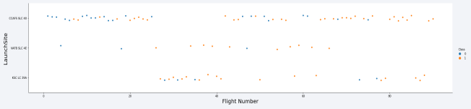
Flight Number vs. Launch Site
• According to the plot above, it’s possible to verify that the best launch site nowadays is CCAF5 SLC 40, where most of recent launches were successful;
• In second place VAFB SLC 4E and third place KSC LC 39A;
• It’s also possible to see that the general success rate improved over time.

Slide 19
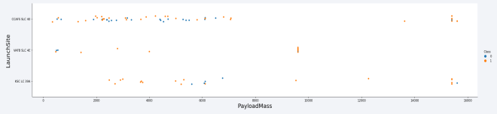
Payload vs. Launch Site
• Payloads over 9,000kg (about the weight of a school bus) have excellent success rate;
• Payloads over 12,000kg seems to be possible only on CCAFS SLC 40 and KSC LC 39A launch sites.

Slide 20
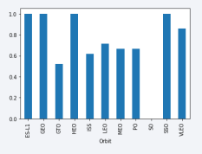
Success Rate vs. Orbit Type
The biggest success rates happens to orbits:
• ES-L1
• GEO
• HEO
• SSO
Followed by:
• VLEO (above 80%); and
• LFO (above 70%).

Slide 21
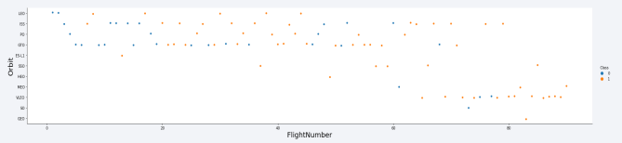
Flight Number vs. Orbit Type
Apparently, success rate improved over time to all orbits.
VLEO orbit seems a new business opportunity, due to recent increase of its frequency.

Slide 22
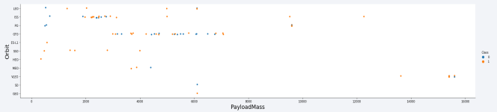
Payload vs. Orbit Type
• Apparently, there is no relation between payload and success rate to orbit GTO
• ISS orbit has the widest range of payload and a good rate of success
• There are few launches to the orbits SO and GEO

Slide 23
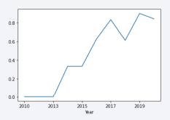
Launch Success Yearly Trend
• Success rate started increasing in 2013 and kept until 2020
• It seems that the first three years were a period of adjusts and improvement of technology.

Slide 24
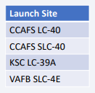
All Launch Site Names
According to data, there are four launch sites, obtained by selecting unique occurrences of “launch_site” values from the dataset:

Slide 25
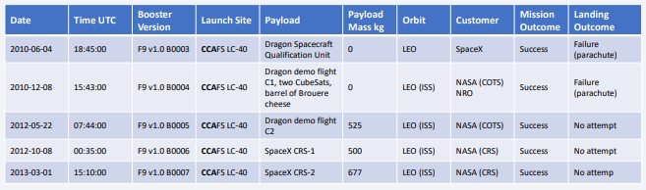
Launch Site Names Begin with 'CCA'
5 records where launch sites begin with `CCA`:

Slide 26
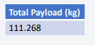
Total Payload Mass
The payload carried by boosters from NASA calculated above, by summing all payloads whose codes contain ‘CRS’, which corresponds to NASA.

Slide 27
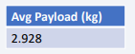
Average Payload Mass by F9 v1.1
Average payload mass carried by booster version F9 v1.1 by Filtering data by the booster version above and calculating the average payload mass we obtained the value of 2,928 kg

Slide 28
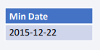
First Successful Ground Landing Date
The first successful landing outcome on ground pad by filtering data by successful landing outcome on ground pad and getting the minimum value for date it’s possible to identify the first occurrence, that happened on 12/22/2015

Slide 29
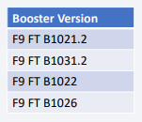
Successful Drone Ship Landing with Payload between 4000 and 6000
Boosters which have successfully landed on drone ship and had payload mass greater than 4000 but less than 6000 selecting distinct booster versions according to the filters above, these 4 are the result.

Slide 30
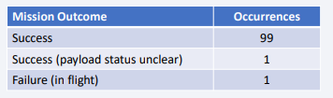
Total Number of Successful and Failure Mission Outcomes
Number of successful and failure mission outcomes grouping mission outcomes and counting records for each group led us to the summary above

Slide 31
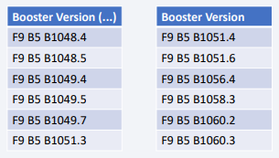
Boosters Carried Maximum Payload
Boosters which have carried the maximum payload mass.
These are the boosters which have carried the maximum payload mass registered in the dataset.

Slide 32
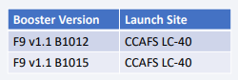
2015 Launch Records
The only two failed landing_outcomes in drone ship, their booster versions, and launch site names for in year 2015.

Slide 33
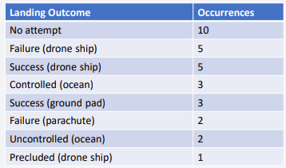
Rank Landing Outcomes Between 2010-06-04 and 2017-03-20
The rank of the count of landing outcomes (such as Failure (drone ship) or Success (ground pad)) between the date 2010-06-04 and 2017-03-20, in descending order:

Slide 34

Section 3

Slide 35
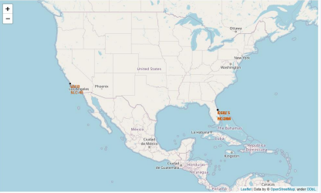
All launch sites
Launch sites are near sea, probably by safety, but not too far from roads and railroads.

Slide 36
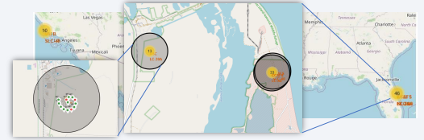
Launch Outcomes by Site
Example of KSC LC-39A launch site launch outcomes.
Green markers indicate successful and red ones indicate failure.

Slide 37
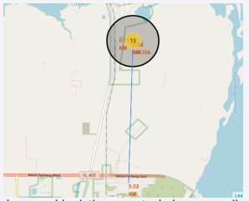
Logistics and Safety
Launch site KSC LC-39A has good logistics aspects, being near railroad and road and relatively far from inhabited areas.

Slide 38

Section 4

Slide 39
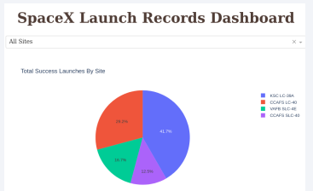
Successful Launches by Site
The place from where launches are done seems to be a very important factor of success of missions.

Slide 40
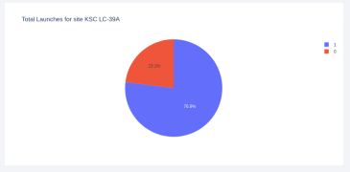
Launch Success Ratio for KSC LC-39A
The launch site with highest launch success ratio is 76.9%.

Slide 41
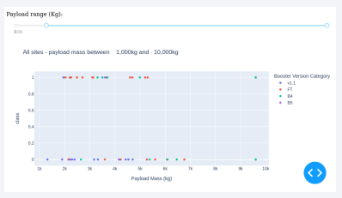
Payload vs. Launch Outcome
Payloads under 6,000kg and FT boosters are the most successful combination.

Slide 42

Section 5

Slide 43
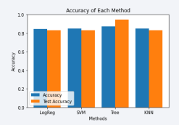
Classification Accuracy
• Four classification models were tested, and their accuracies are plotted beside.
• The model with the highest classification accuracy is Decision Tree Classifier, which has accuracies over than 87%.

Slide 44
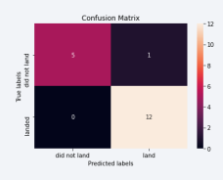
Confusion Matrix
Confusion matrix of Decision Tree Classifier proves its accuracy by showing the big numbers of true positive and true negative compared to the false ones.

Slide 45
Conclusions
Different data sources were analyzed, refining conclusions along the process:
• The best launch site is KSC LC-39A
• Launches above 7,000kg are less risky
• Although most of mission outcomes are successful, successful landing outcomes seem to improve over time, according the evolution of processes and rockets
• Decision Tree Classifier can be used to predict successful landings and increase profits.

Slide 46
Appendix
As an improvement for model tests, it’s important to set a value to “np.random.seed” variable

Slide 47


